Slide 1
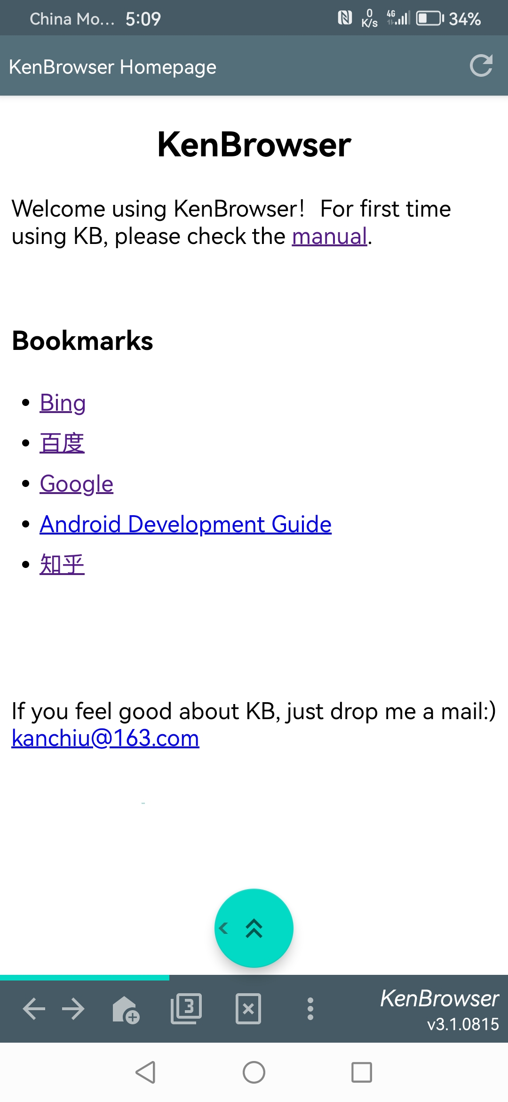
Tiny and clean
App small as 4m size
No ad and unnecessary functions

Slide 2
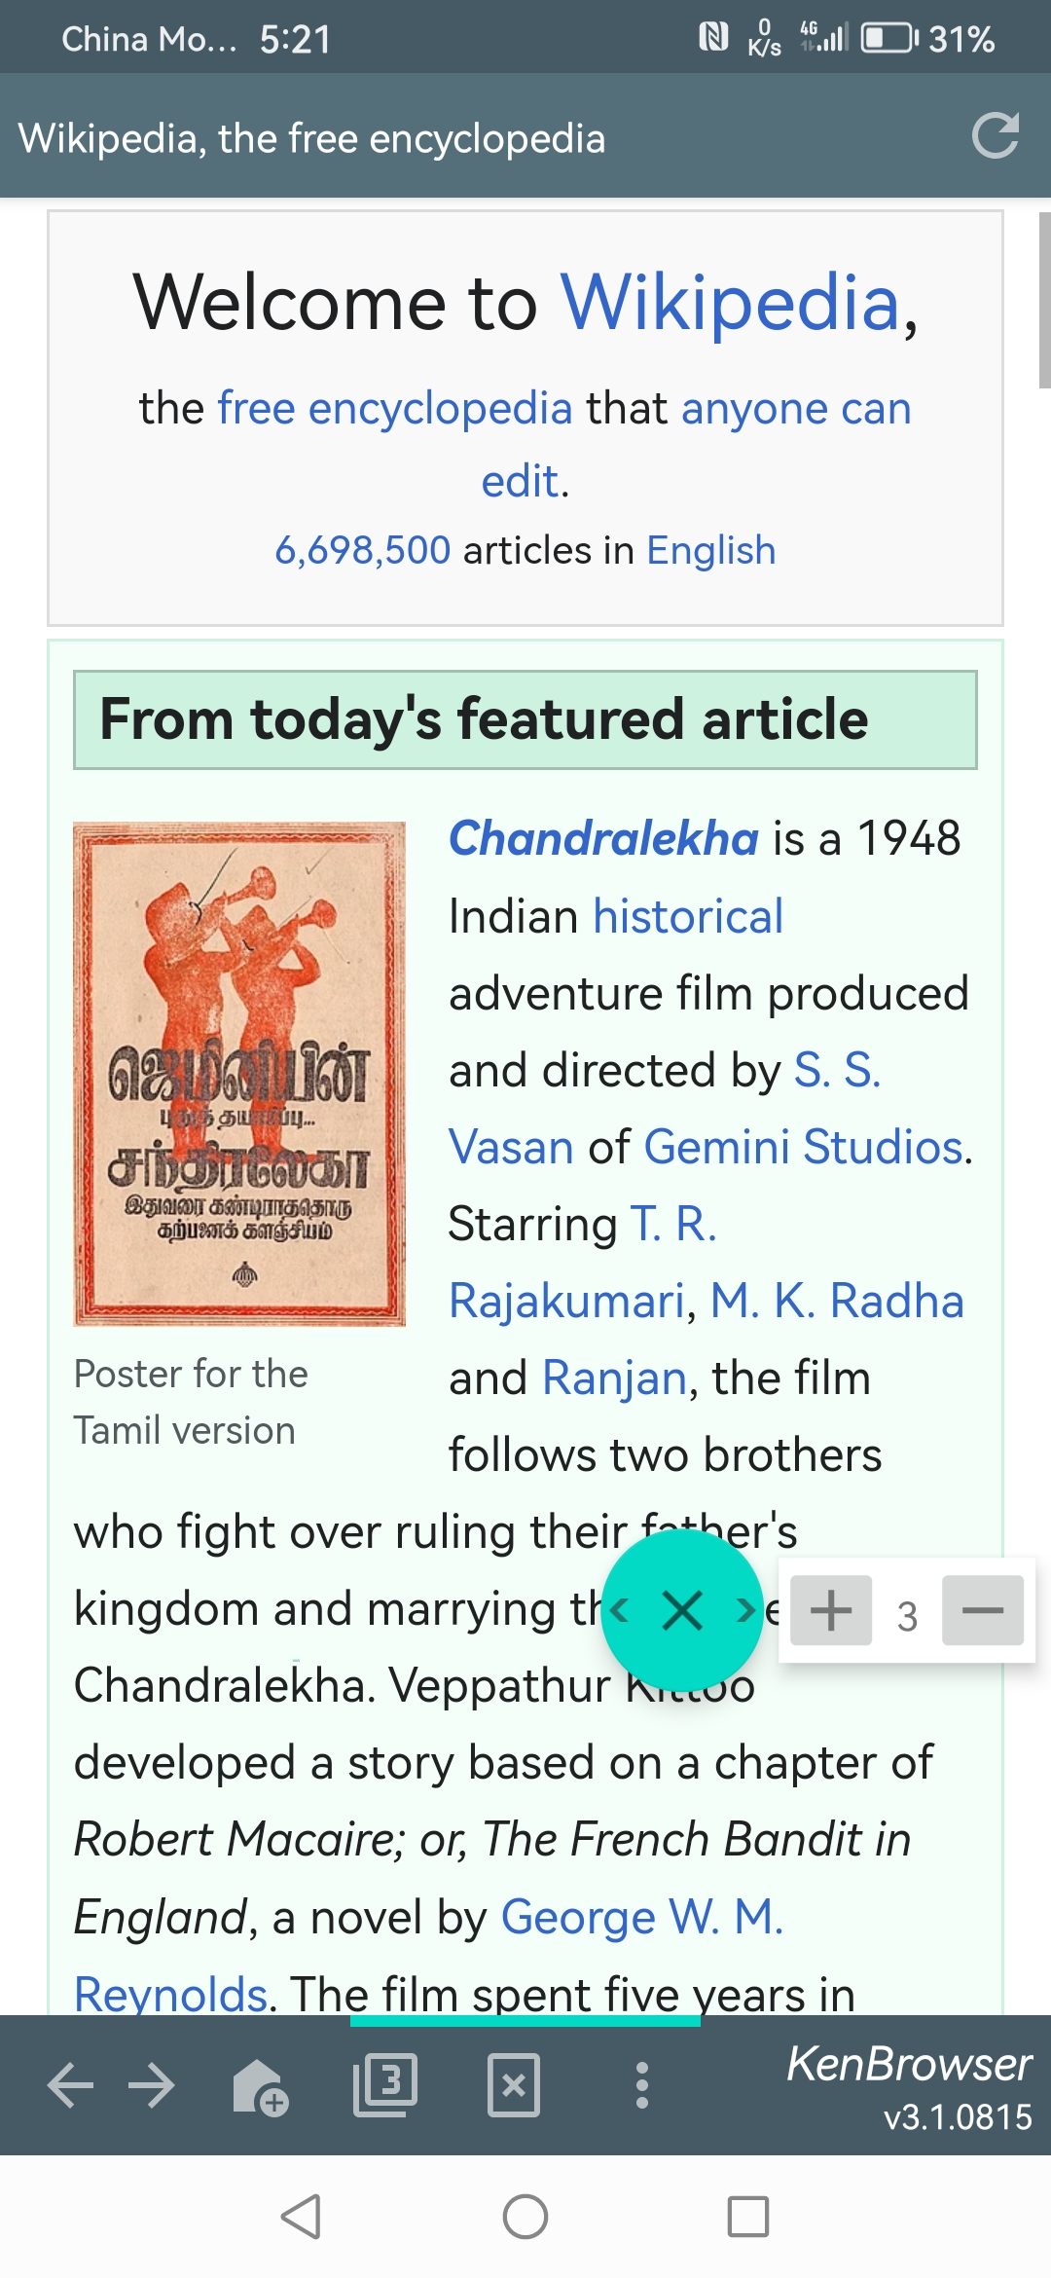

Floating Button
Scroll up/down, swipe left/right
Auto-scrolling with speed control
Page browsing with only one finger
Floating button:
Click: scroll up
Double-click: auto-scroll
Long-click: drag & move
Swipe-out: swipe page
Touch & swipe out of the button boundary, trigger page swipe.

Slide 3
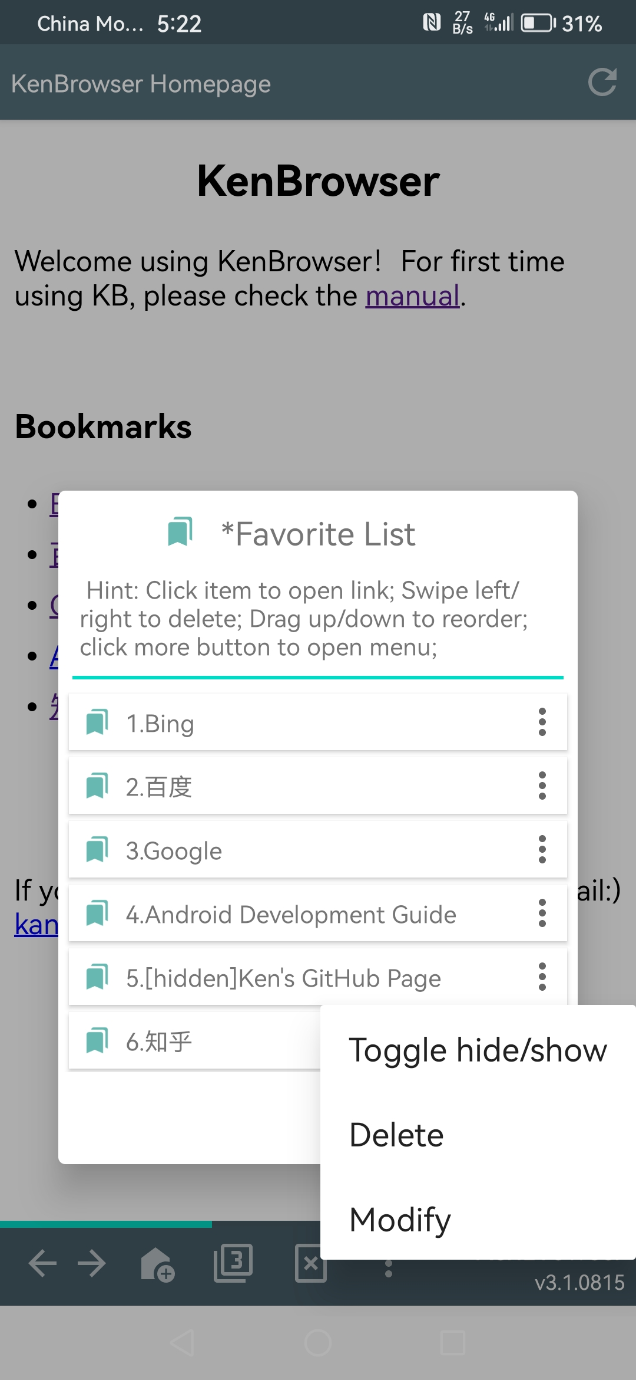
Hidden Bookmarks
Toggle hide/show your private bookmarks
Double-click the title to show hidden bookmarks
双击显示隐藏的书签
When showing hidden bookmarks, click to toggle status

Slide 4
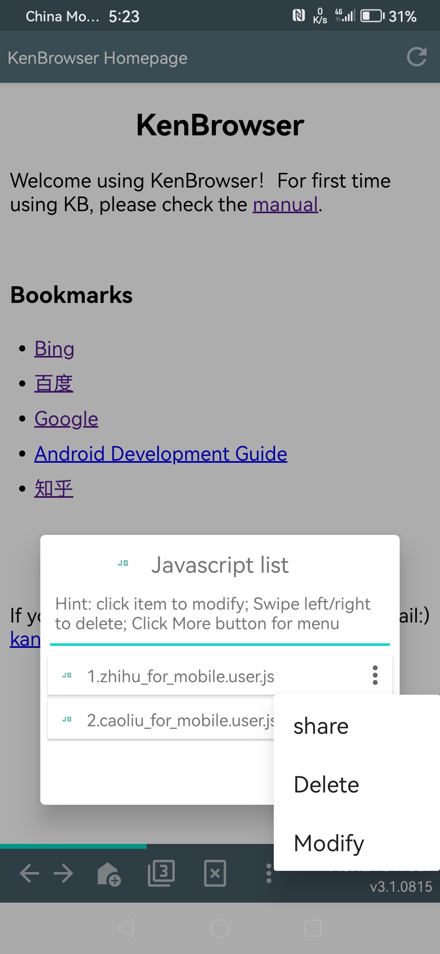
Inject Javascript
Support TamperMonkey scripts
Enhance browser function unlimitedly

Slide 5
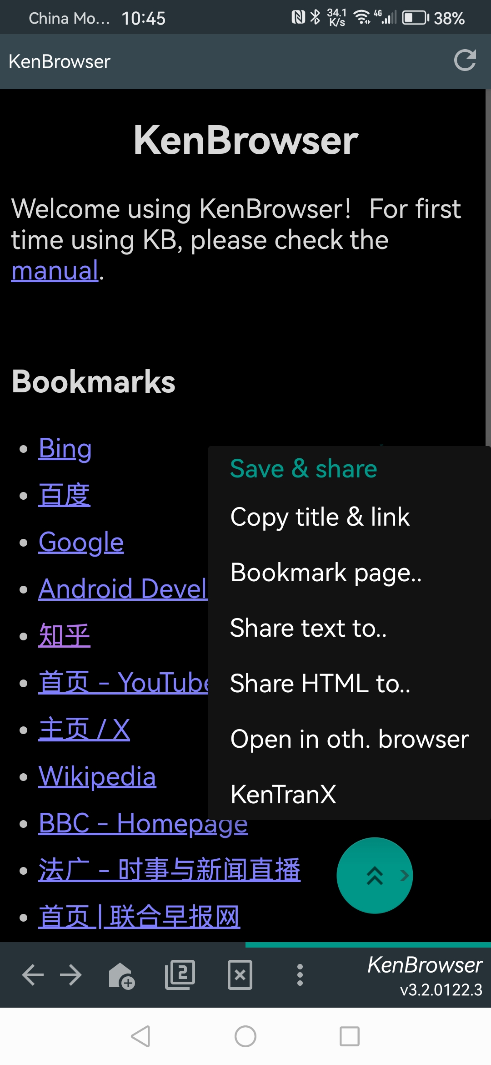
Powerful Share
Support night mode

Slide 6
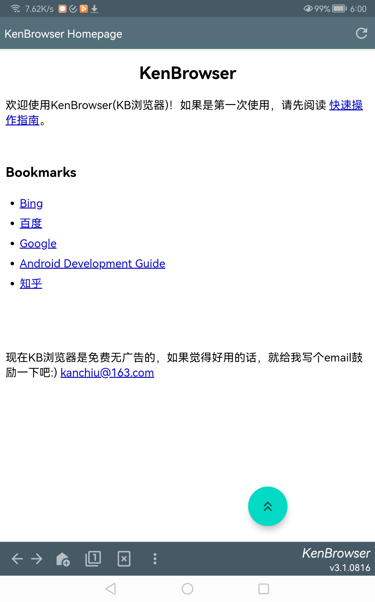
Tiny and clean
App small as 4m size
No ad and unnecessary functions

Slide 7
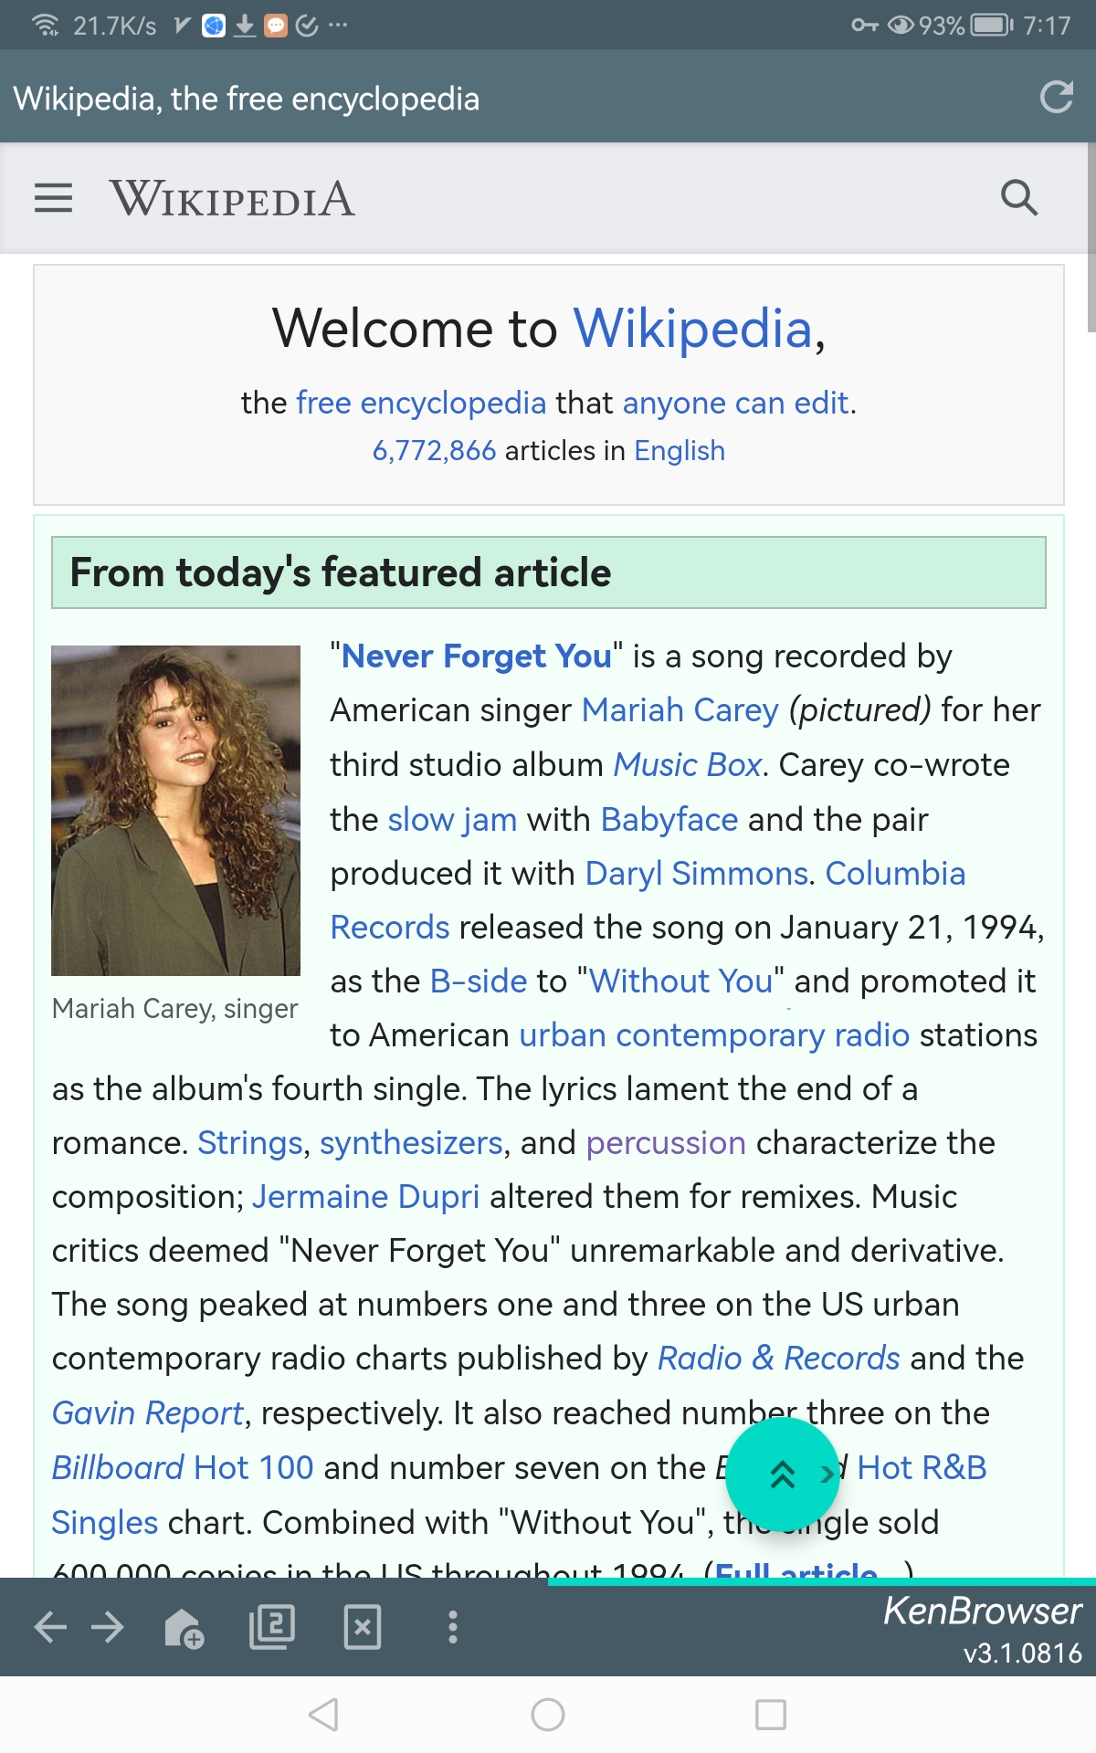
Floating Button
Scroll up/down, swipe left/right
Auto-scrolling with speed control
Page browsing with only one finger
Floating button:
Click: scroll up
Double-click: auto-scroll
Long-click: drag & move
Swipe-out: swipe page
Touch & swipe out of the button boundary, trigger page swipe.

Slide 8
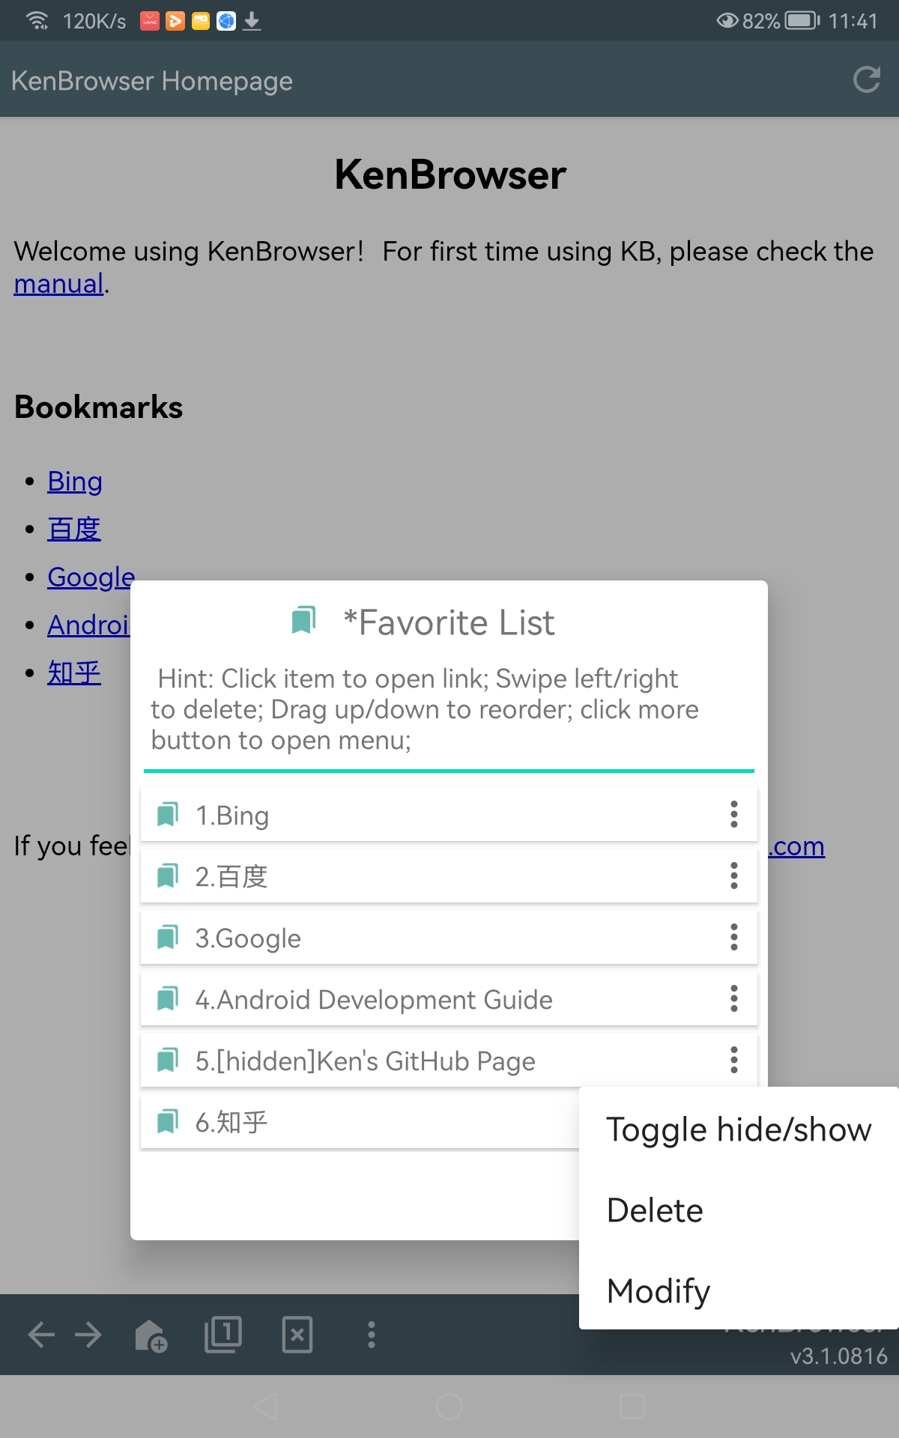
Hidden Bookmarks
Toggle hide/show your private bookmarks
Double-click the title to show hidden bookmarks
双击显示隐藏的书签
When showing hidden bookmarks, click to toggle status

Slide 9
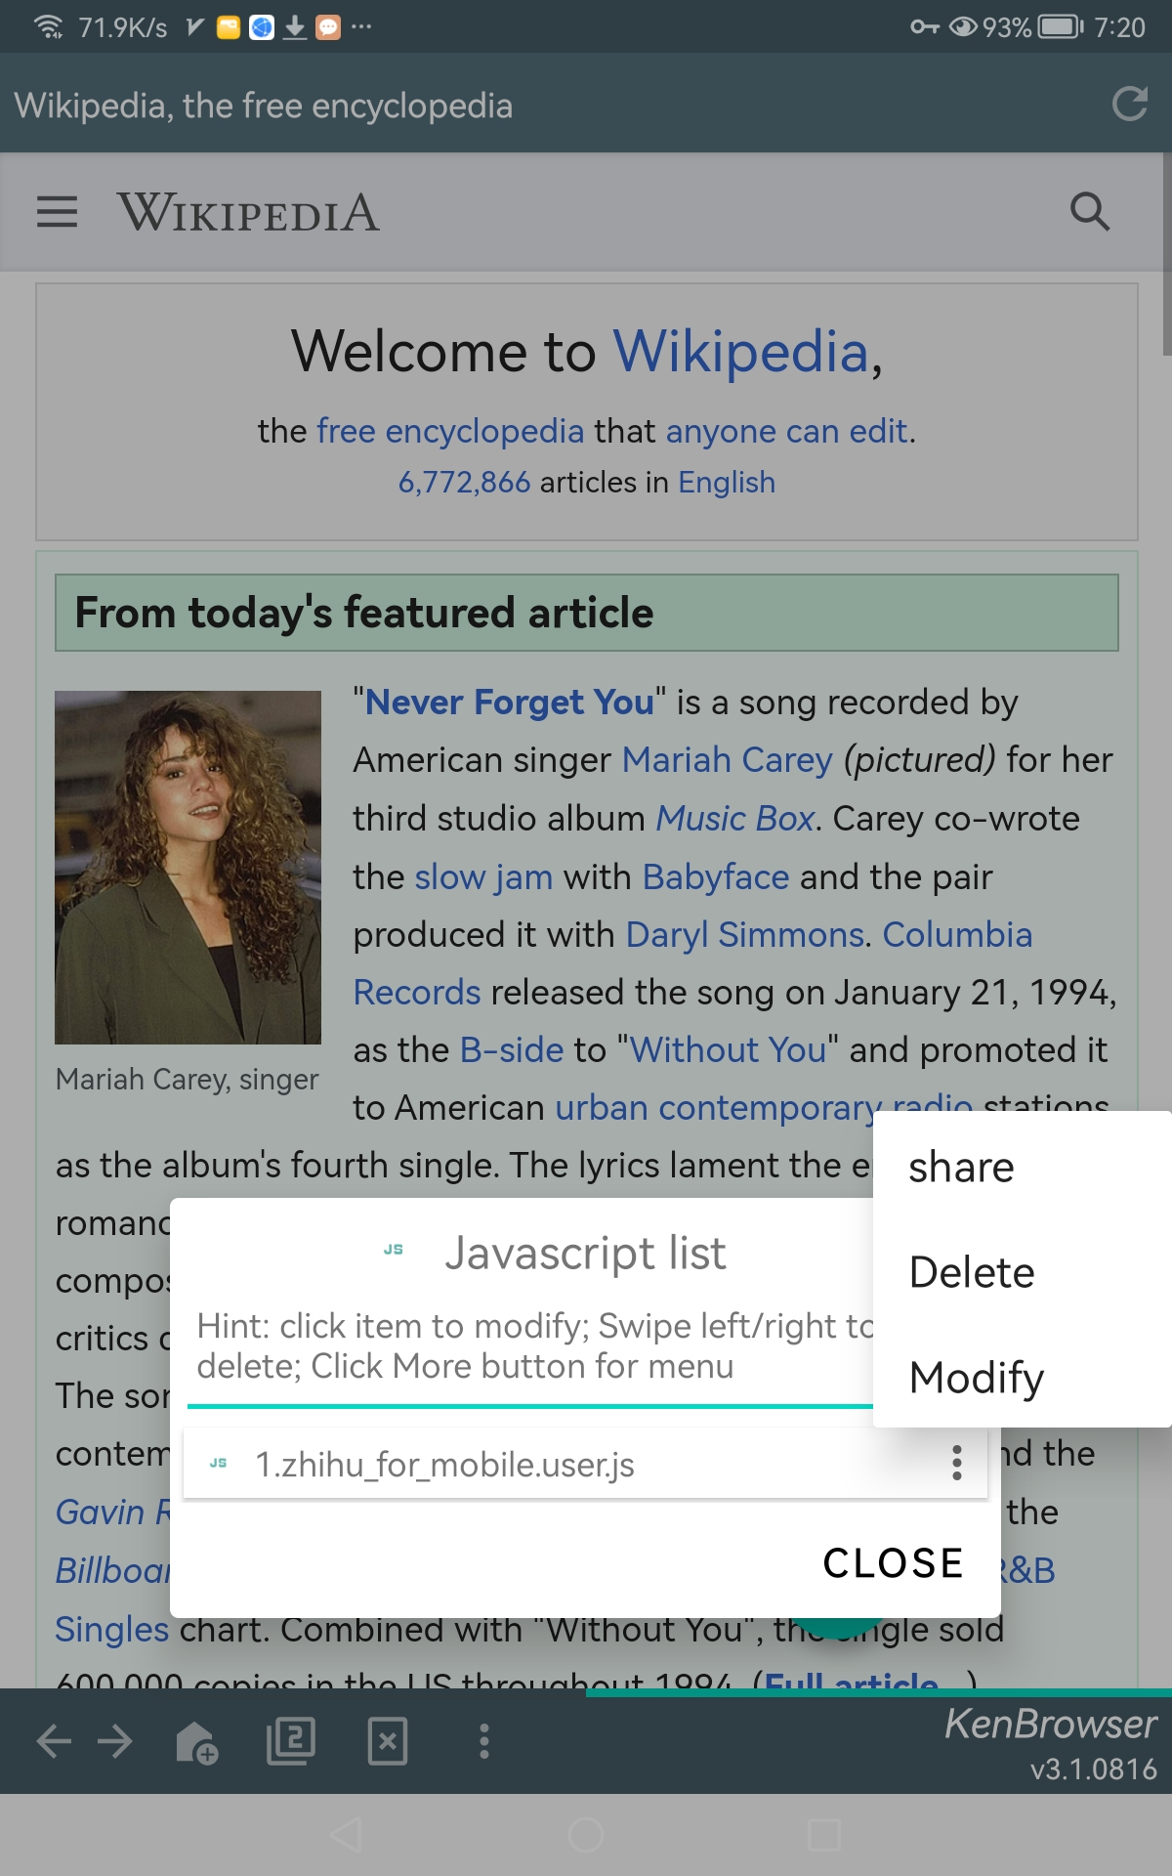
Inject Javascript
Support TamperMonkey scripts
Enhance browser function unlimitedly

Slide 10
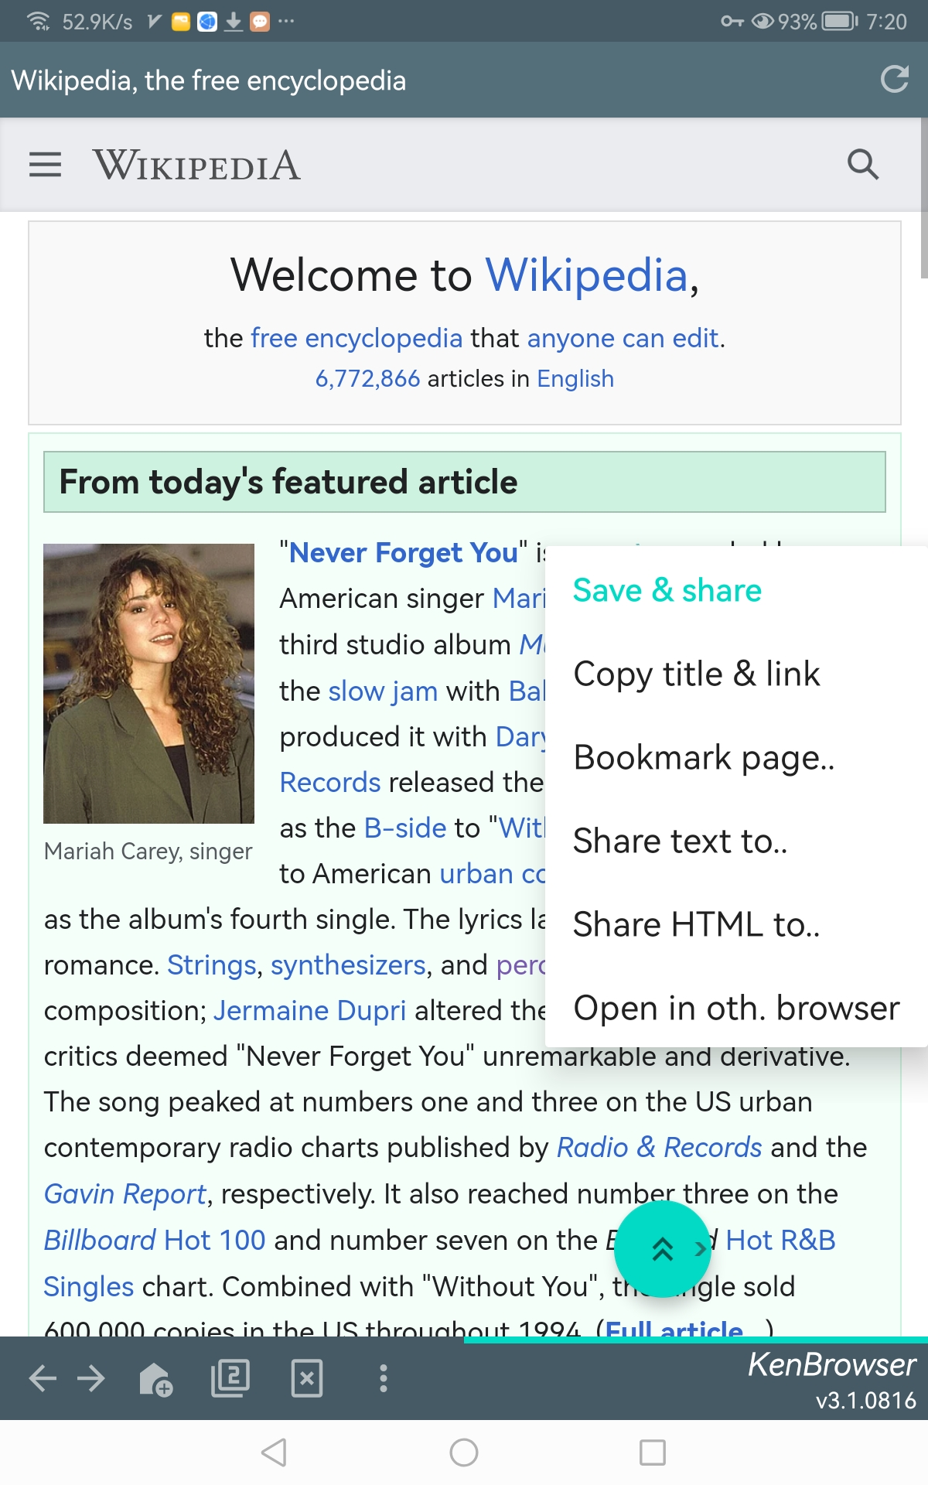
Powerful Share

Slide 11
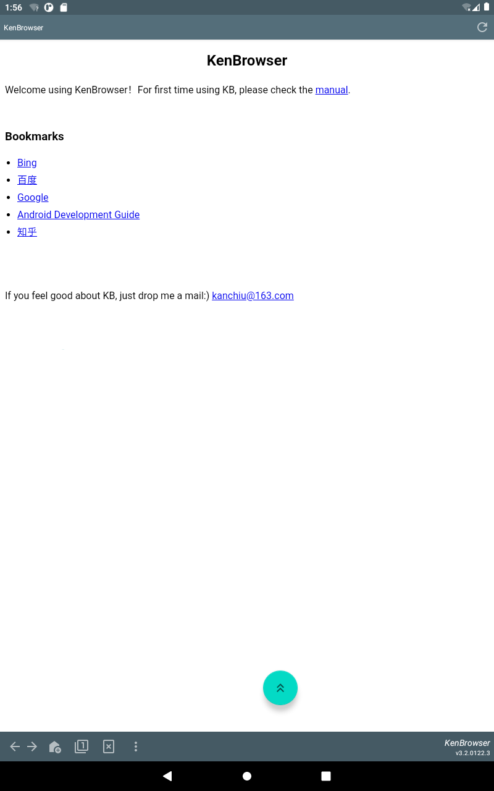
Tiny and clean
App small as 4m size
No ad and unnecessary functions

Slide 12
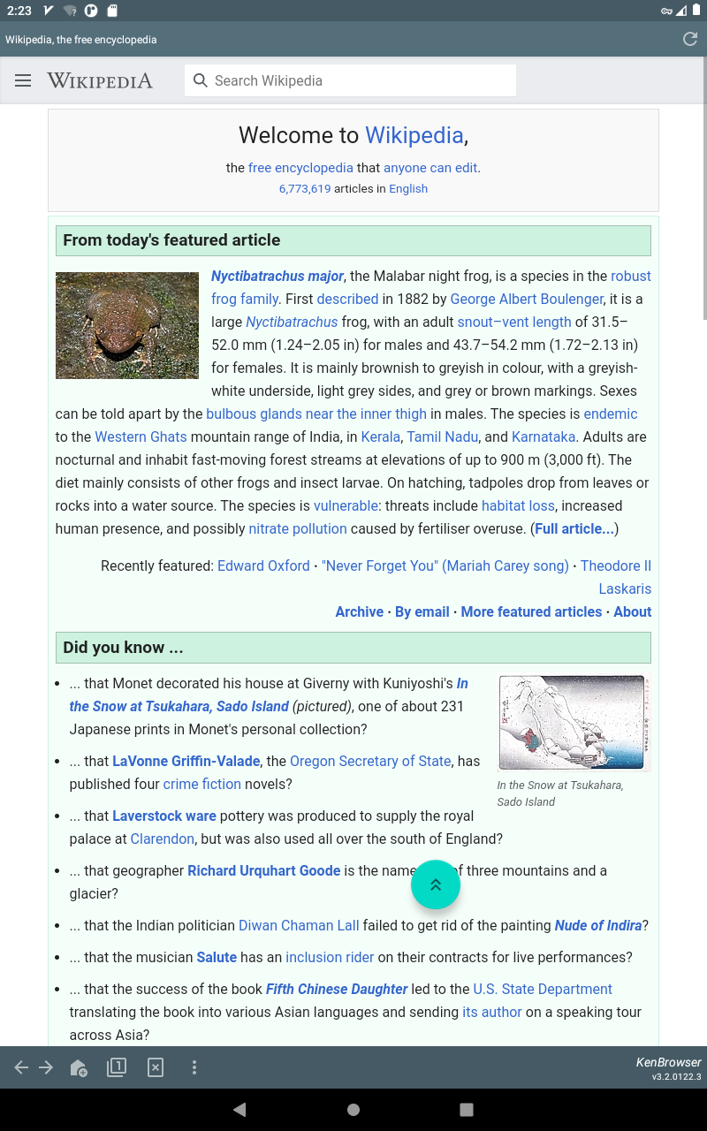
Floating Button
Scroll up/down, swipe left/right
Auto-scrolling with speed control
Page browsing with only one finger
Floating button:
Click: scroll up
Double-click: auto-scroll
Long-click: drag & move
Swipe-out: swipe page
Touch & swipe out of the button boundary, trigger page swipe.

Slide 13
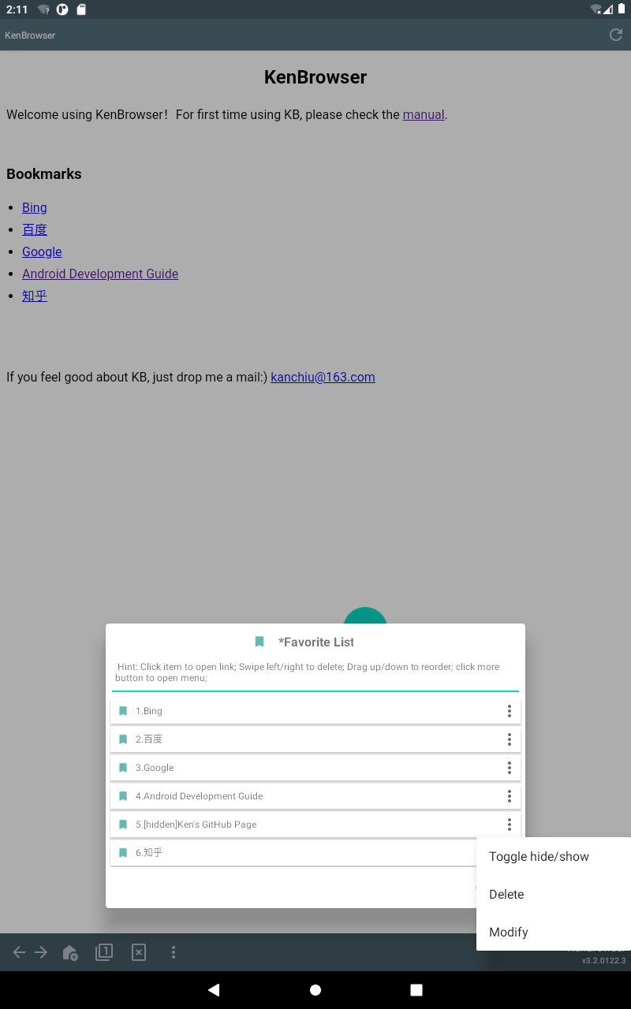
Hidden Bookmarks
Toggle hide/show your private bookmarks
Double-click the title to show hidden bookmarks
双击显示隐藏的书签
When showing hidden bookmarks, click to toggle status

Slide 14
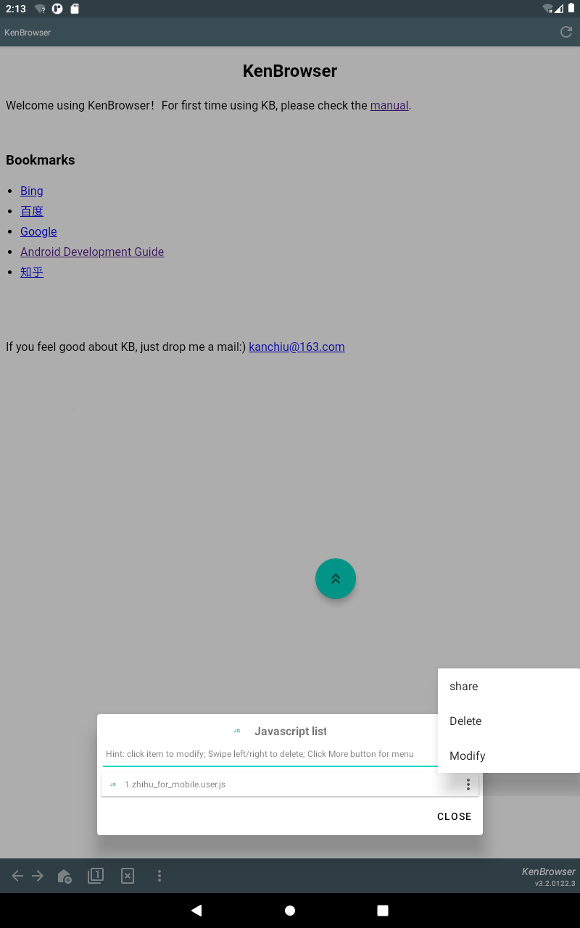
Inject Javascript
Support TamperMonkey scripts
Enhance browser function unlimitedly

Slide 15
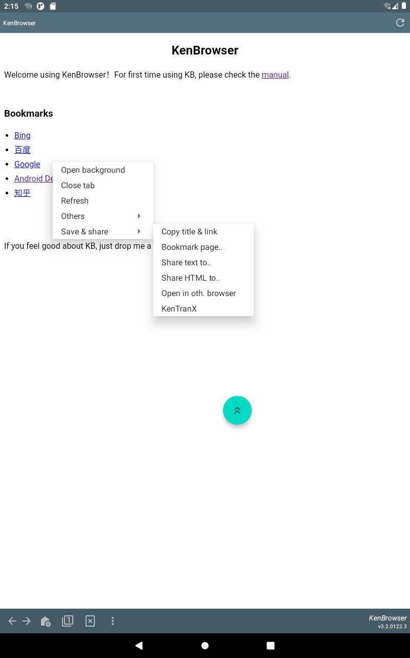
Powerful Share

